Slide 1
Path Finding Algorithm for Martian Cities
By Akarsh kumar

Slide 2
Path Finding
Path finding is the act finding the shortest path from one point to another, given a graph of nodes to traverse through.
Dijkstra's algorithm is used to find the shortest path from one point to another.
A* is an optimization to Dijkstra's that is helpful if there is one goal.
Both path finding algorithms start from the starting point and expand in a circle/oval shape outward calculating the shortest paths to each node it traverses.

Slide 3
Warm Up Problem
The shortest path was found by using the A* algorithm.
This was ideal because there was one ending point only.
Heuristic was made by calculating the Manhattan distance to the closest end location.
Rules: Green is start, red is goal, white pixels cost 1 to move on, blue pixels cost 2 to move on, black pixels cannot be moved on.
The solution is the shortest path highlighted in cyan (next slide).

Slide 4
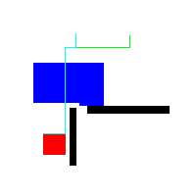
Warmup Shortest Path Solution

Slide 5
Shortest Path to Martian Cities
To find the shortest path from my Martian city to others, I used Dijkstra's algorithm because A* is not helpful for multiple goal cities.
My implementation of the frontier used PriorityQueue in order to get the lowest cost Coordinate on frontier fast.
The

Slide 6
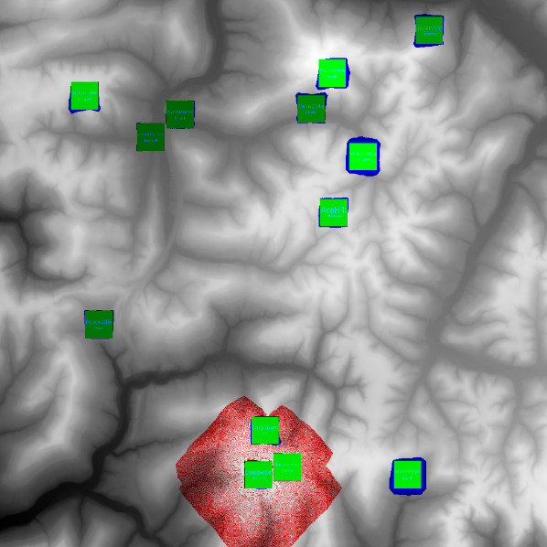
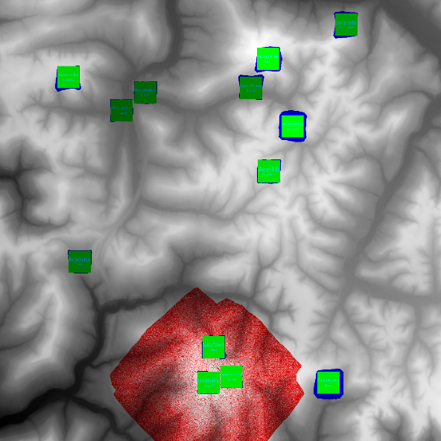
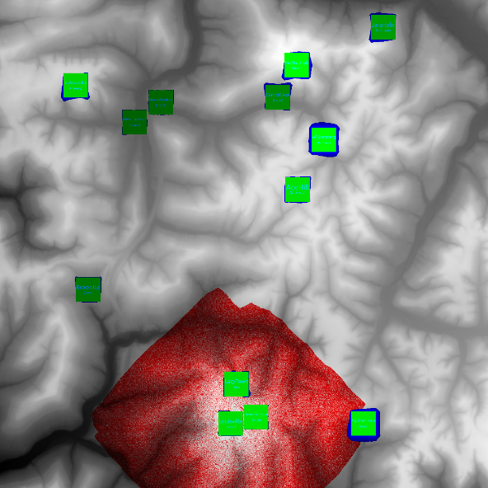
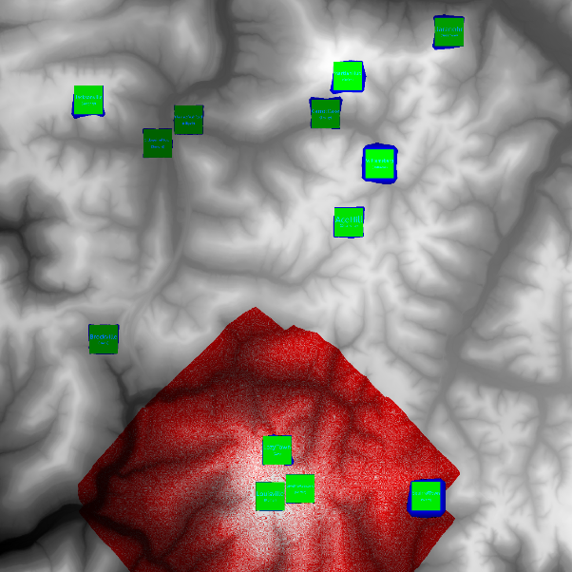
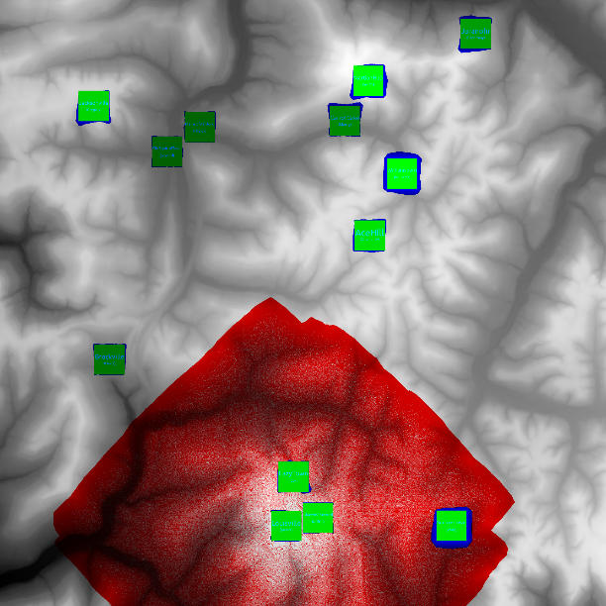
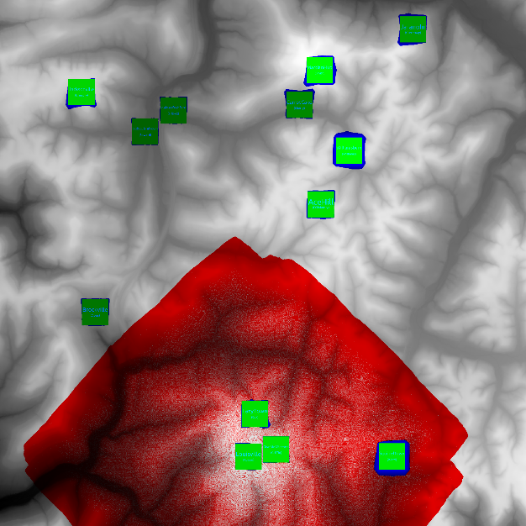
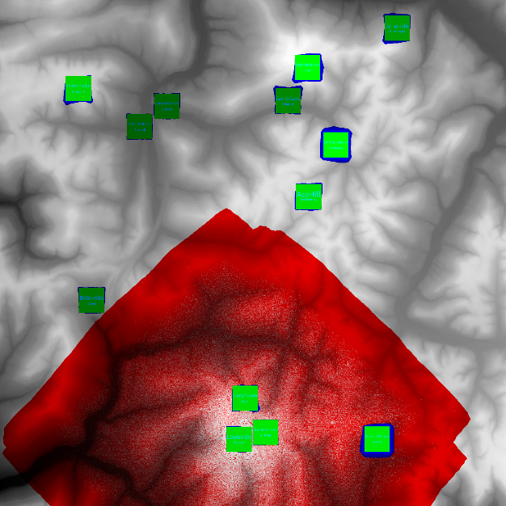
The Expanding Frontier

